Slide 1
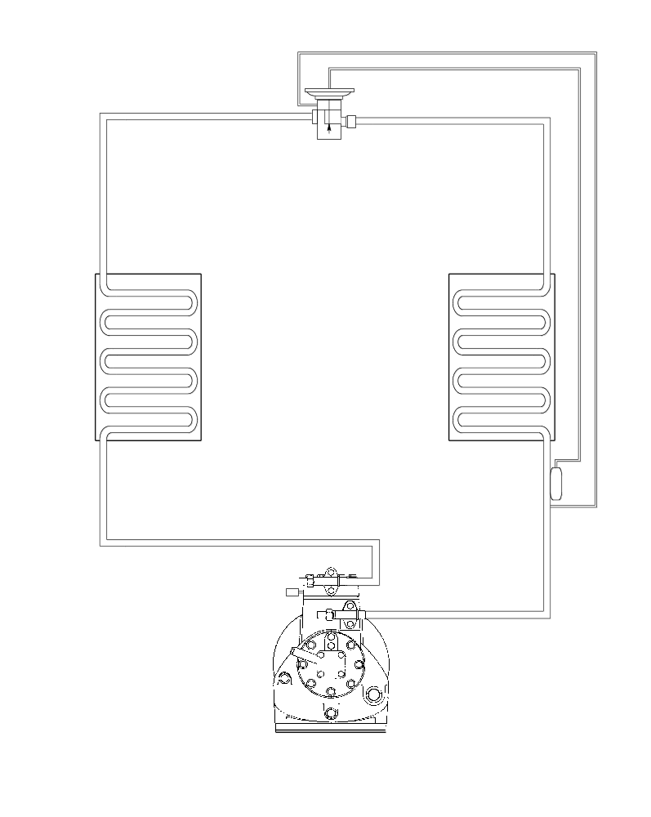
Basic
Refrigeration
System
4 Component Flow Diagram

Slide 2
The High Side

Slide 3
Thermal Expansion Valve
HT HP SCL
HT HP S.M.
Condenser
HT HP SHV
Discharge
Service
Valve
Compressor
Legend
HT HP SHV
HT HP S.M.
HT HP SCL
The High Side

Slide 4
The Low Side

Slide 5
Equalization Line
Thermal Expansion Valve
Flash Gas
LT LP S.M.
Evaporator
TXV Bulb
LT LP SHV
Compressor
Suction
Service Valve
Legend
LT LP S.M.
LT LP SHV
The Low Side

Slide 6
The System

Slide 7
High Side
Conditioned Space
Ambient
Air
Return
Air
Supply Air
Low Side

Slide 8
System Pressures

Slide 9
R-134a
Saturation Temp. = 124° F.
You have a discharge Pressure of 182.00 PSIG.
What do you know about the refrigerant?

Slide 10
R-134a
Saturation Temp. = 114° F.
Temp. Taken in this area!
HT HP SHV Superheated by 6° F.
You have a Discharge Pressure of 156.10 PSIG. You find a temperature on the high side of 120° F.
What do you know about the refrigerant?

Slide 11
R-134a
HT HP SCL
Sub-cooled by 10° F.
Temp. Taken in this area!
Saturation Temp. = 120° F.
You have a Discharge Pressure of 171.30 PSIG. You find a temperature on the high side of 110° F.
What do you know about the refrigerant?

Slide 12
R-134a
LT LP S.M.
Saturation Temp. = -2° F.
You have a Suction Pressure of 5.50 PSIG. What do we know about the refrigerant leaving the TXV?

Slide 13
R-134a
Saturation Temp. = -2° F.
LT LP SHV Superheated by 7° F.
You have a Suction Pressure of 5.50 PSIG. You find a temperature at the TXV Bulb of 5.0° F.
What do you know about the refrigerant?

